Slide 1


Task X
McKenzie Murphy

Slide 2
Schedule
What Is Aereo
How Does Aereo Work
Aereo In the News
Who Cares

Slide 3
What Is Aereo

Slide 4
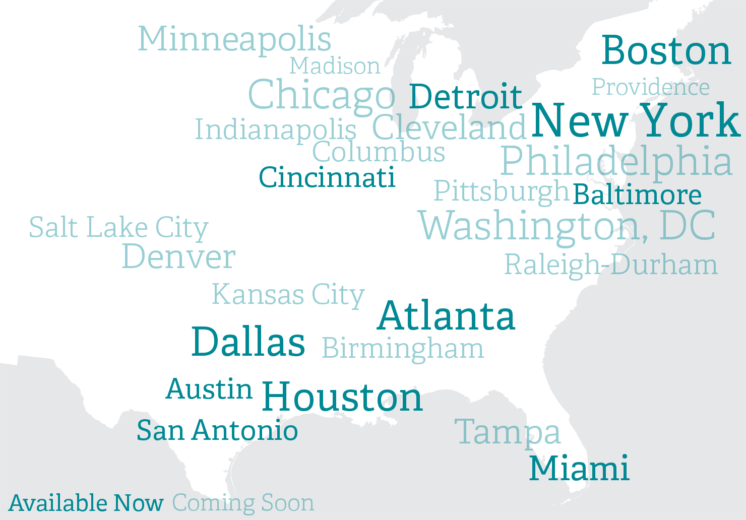
What Is Aereo

Slide 5
How Does Aereo Work

Slide 6
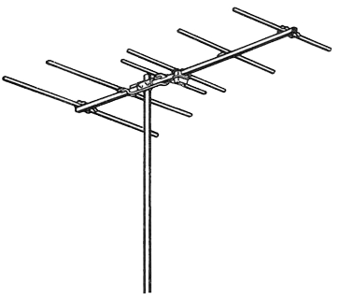
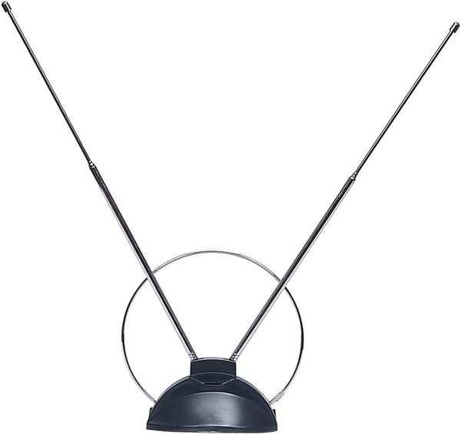
How Does Aereo Work

Slide 7

How Does Aereo Work

Slide 8
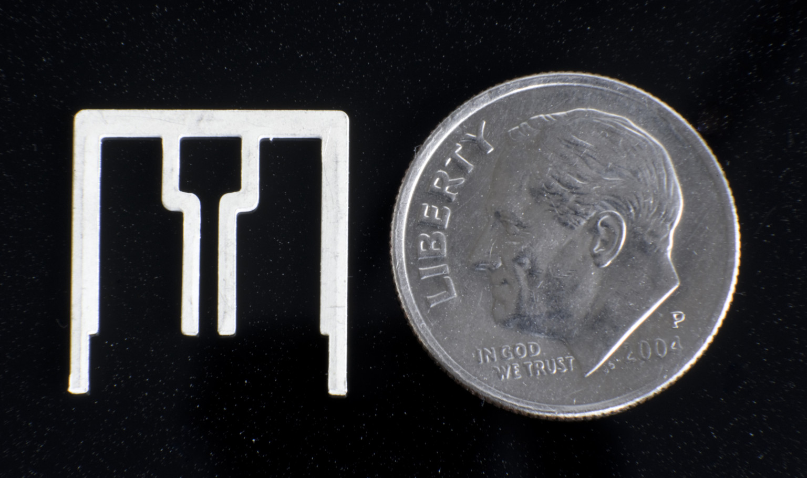
How Does Aereo Work

Slide 9
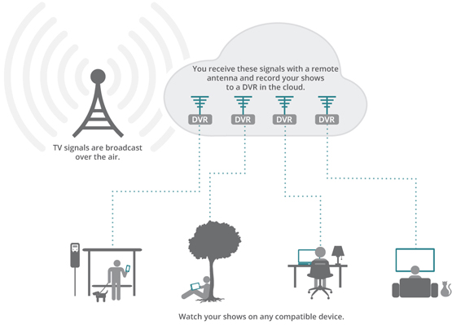
How Does Aereo Work

Slide 10
Many – Many Distribution

Slide 11
Aereo In The News

Slide 12
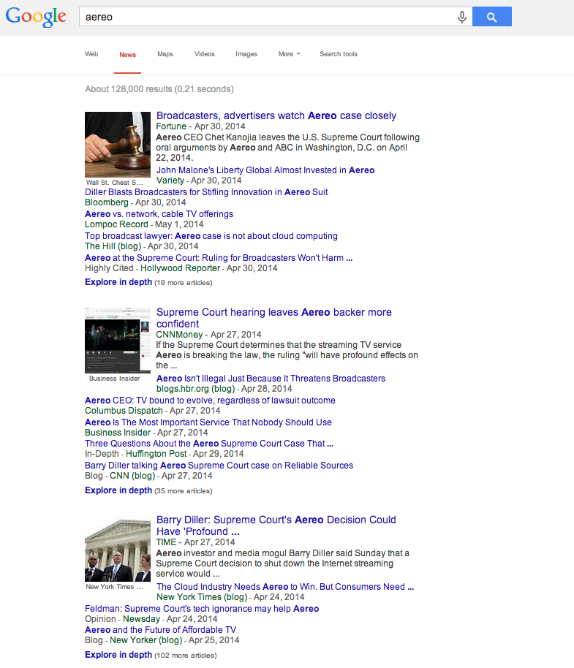

Slide 13
Aereo In The News
“…Aereo service violates copyright laws because it retransmits broadcast TV without a license.”

Slide 14
Aereo In The News
“Unlike a purveyor of home antennas […] respondent does not simply provide access to equipment or other property that facilitates customers' reception of broadcast signals. Rather, respondent operates an integrated system -- i.e., a 'device or process' -- whose functioning depends on its customers' shared use of common facilities.”

Slide 15
One – Many Distribution

Slide 16
Aereo In The News
“The broadcasters’ overreaching copyright arguments would, if accepted, cause grave harm to consumers, cloud-based technology and future innovation. In a case about Aereo, the broadcasters go well beyond Aereo and attack the legal underpinning of all cloud-based services, everything from the Apple iCloud to Cablevision’s own remote-storage DVR service.”

Slide 17
Who Cares
“To stop Aereo, you’d be stopping entire industries.”

Slide 18
Sources
https://aereo.com/
http://www.pcmag.com/article2/0,2817,2417555,00.asp
http://variety.com/2013/biz/news/cablevision-aereo-is-illegal-but-broadcasters-are-wrong-in-their-attack-on-startup-1200948485/

